Slide 1

PRESENTED BY OISHIKA BOSE
Zudio Retail Sales & Store Performance Analysis
Tools Used-
MySQL Workbench

Slide 2
PROBLEM STATEMENT
OBJECTIVE OF THE ANALYSIS
Currently, business data exists in a raw, transactional format, making it difficult to derive meaningful insights such as:
Which stores and regions contribute the most to revenue
How customer purchasing behavior varies across locations.
Which product categories and clothing types drive sales, and which underperform.
How sales trends change over time (monthly, seasonally).
Whether store size, store type (owned vs rented), and staffing impact profitability .
Without a structured analytical approach, decision-making related to inventory planning, store expansion, pricing strategy, and marketing focus becomes inefficient and reactive.
The objective of this project is to use SQL-based data modeling and analysis to:
Transform raw sales data into clean, normalized tables
Analyze sales performance, customer behavior, product demand, and store efficiency
Identify high-performing and low-performing stores, products, and customers
Provide data-driven insights that support strategic decisions

Slide 3
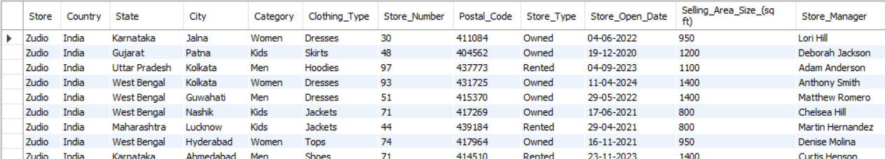
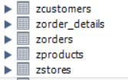
DATASET DESCRIPTION
Data Modeling & Preparation
The original Zudio dataset was first imported as a raw master table to preserve the source data.
The master table was then normalized into smaller relational tables (Stores, Products, Customers, Orders, and Order Details) to reduce redundancy.
This structure enabled efficient querying, better data integrity, and accurate business analysis
Total rows 7899, total columns- 20
Data Source- Kaggle
Domain | Columns
Store Info | Store, Store Number, Store Type, Store Open Date, Selling Area Size, Staff Count
Location | Country, State, City, Postal Code
Product Info | Category, Clothing Type, Product ID, Price
Customer Info | Customer ID, Customer Name
Order & Time | Order ID, Order Date, Month
Sales Metrics | Quantity, Sales Profit
The Main Dataset
Normalized Tables From The Main Dataset

Slide 4
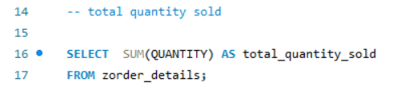


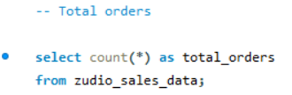


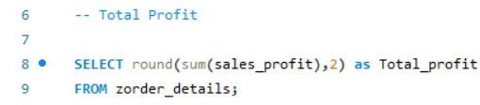

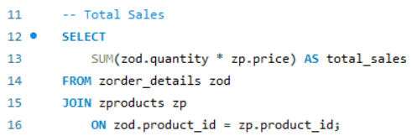

KEY METRICS
Business Questions | Insight from Output
What is the total quantity of items sold? | A total of 35,699 units were sold, indicating overall product demand across all orders.
How many total orders were placed? | The business processed 7,899 orders, reflecting the transaction volume during the period.
What is the total profit generated? | The total profit amounts to 25,045,133.20, showing strong overall profitability.
What is the total sales value? | Total sales reached 686,445,368, highlighting high revenue generation from product sales.

Slide 5
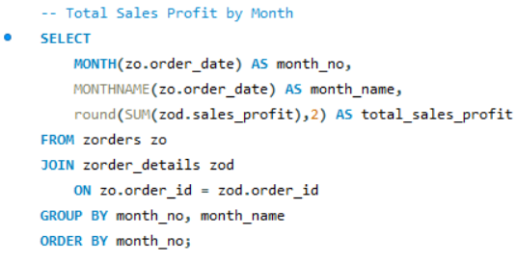
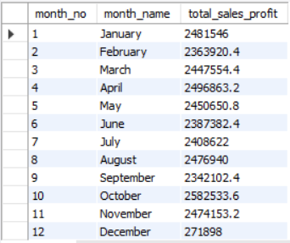
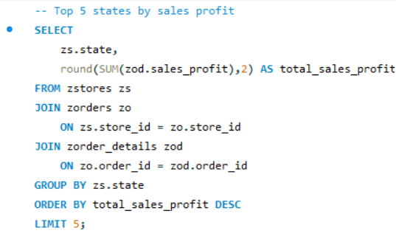
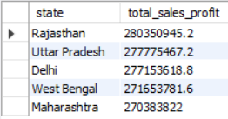
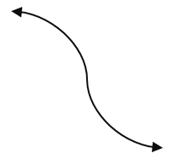
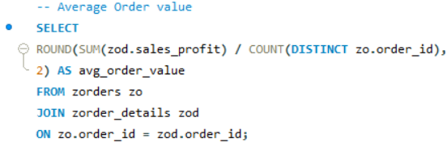
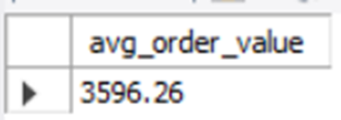
SALES ANALYSIS
Business Questions | Insights
How does sales profit vary month-wise? | Sales profit fluctuates across months, with October and November showing stronger profitability, indicating seasonal demand.
Which states contribute the most to sales profit? | Rajasthan, Uttar Pradesh, and Delhi are the top contributors, highlighting key high-performing markets.
What is the average order value? | The average order value is 3,596.26, reflecting moderate customer spending per transaction.

Slide 6
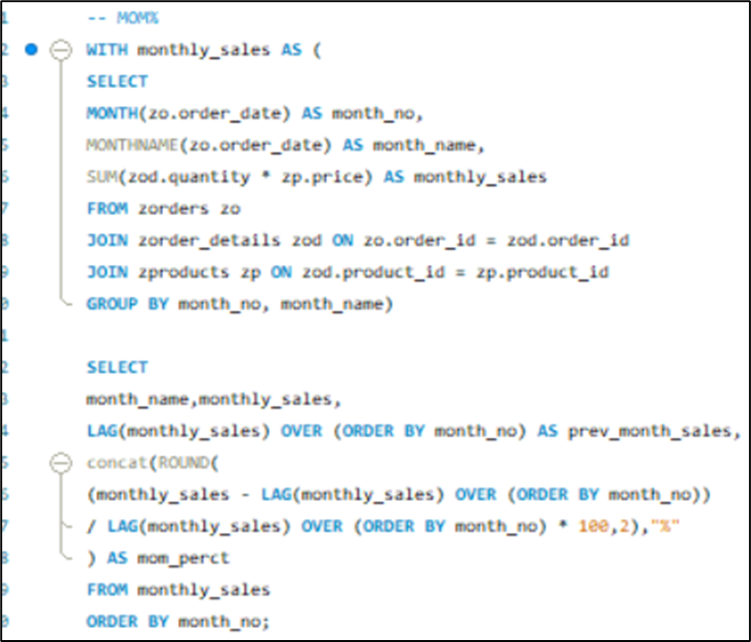
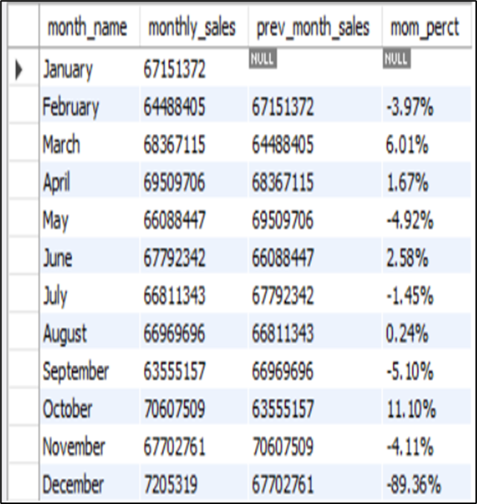
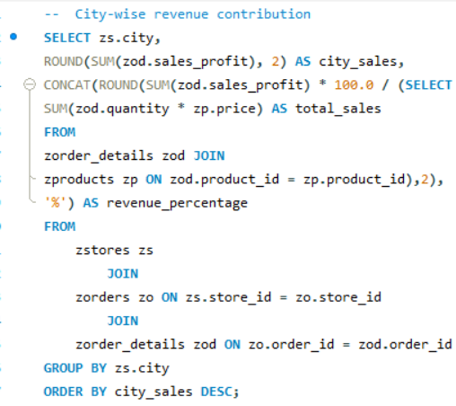
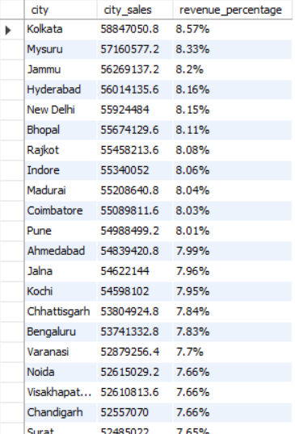
SALES ANALYSIS
Business Questions | Insights
How does month-over-month sales performance change? | Sales show both growth and decline across months, with sharp drops in December, signaling possible season-end slowdown.
Which cities contribute the highest share of revenue? | Kolkata, Mysuru, and Jammu lead city-wise revenue contribution, indicating strong urban demand concentration.

Slide 7
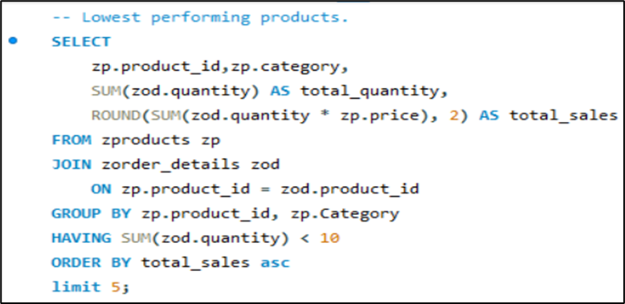
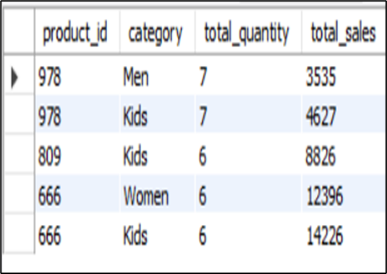
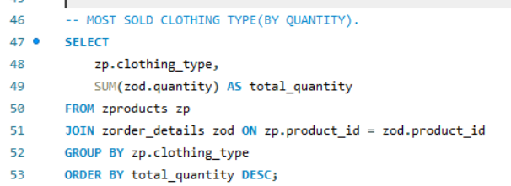
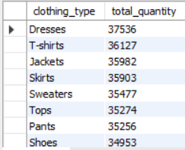
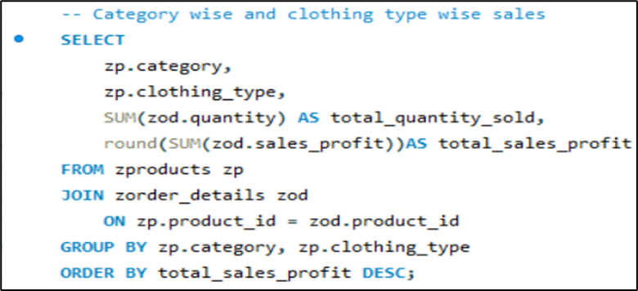
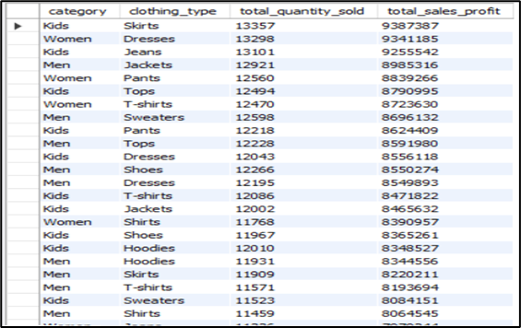
PRODUCT ANALYSIS
Business Questions | Insights
Which products are the lowest performing? | Certain Kids and Women category products have very low quantities and sales, making them candidates for discontinuation.
What are the most sold clothing types by quantity? | Dresses, T-shirts, Jackets, and Skirts dominate sales volume, showing customer preference for apparel staples.
Which category–clothing combinations generate the highest profit? | Men and Women categories combined with Dresses and Tops generate higher profits, driving core revenue.

Slide 8
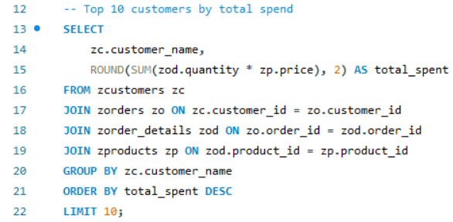
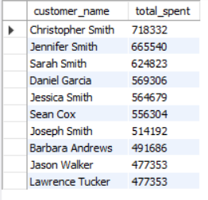
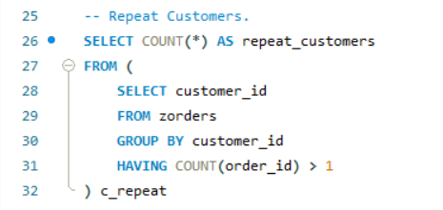

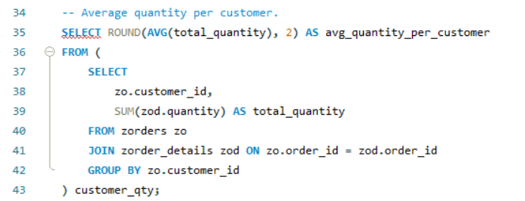

CUSTOMER ANALYSIS
Business Questions | Insights
Who are the top customers by total spend? | A small group of customers contributes significantly, with Christopher Smith being the highest spender.
How many repeat customers does the business have? | There are 29 repeat customers, indicating limited but valuable customer retention.
What is the average quantity purchased per customer? | On average, each customer purchases 5 items, suggesting moderate basket size.

Slide 9
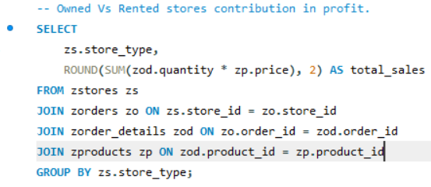

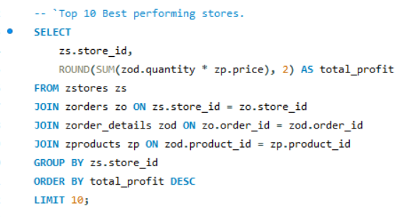
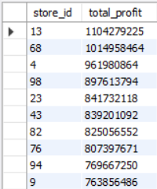
STORE PERFORMANCE
Business Question | Insights
How do owned vs rented stores perform in sales? | Rented stores slightly outperform owned stores in total sales, suggesting better location or scalability.
Which stores are the top profit generators? | Store IDs 13, 68, and 4 lead in profit, representing best-performing outlets.

Slide 10
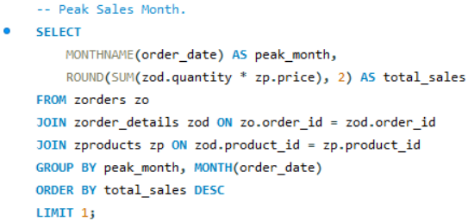

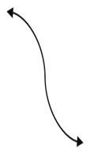
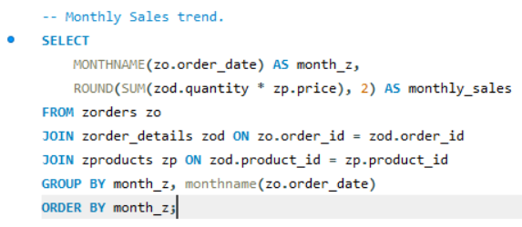
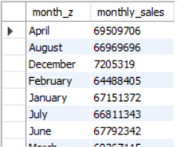
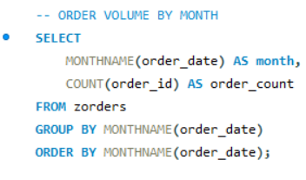
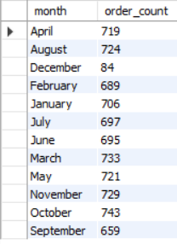
TIME-BASED ANALYSIS
Business Questions | Insights
Which is the peak sales month? | October is the peak sales month, indicating strong festive or seasonal demand.
What is the overall monthly sales trend? | Sales remain relatively stable with peaks around April, August, and October, showing cyclical buying behavior.
How does order volume vary by month? | October and November record the highest order volumes, aligning with peak sales periods.

Slide 11
CONCLUSION & SUGGESTIONS
CONCLUSIONS
SUGGESTIONS
Sales performance is seasonal, with peak activity in October and November, indicating strong festive demand.
Rented stores outperform owned stores, suggesting location advantage and better footfall.
A small group of customers contributes disproportionately to revenue, highlighting dependence on high-value customers.
Dresses, T-shirts, and Jackets are the most demanded clothing types, driving volume and profit.
Several low-performing products and categories exist, negatively impacting inventory efficiency.
Repeat customer count is low, indicating scope for improving customer loyalty.
Focus on Seasonal Peaks- Strengthen marketing and inventory during October–November to maximize sales.
Optimize Store Mix- Prioritize rented stores in high-performing regions and review low-performing owned stores.
Refine Product Portfolio- Boost high-demand categories and reduce or reprice low-performing products.
Improve Customer Retention- Implement loyalty programs and personalized offers to increase repeat customers.
Leverage Top Regions- Invest more in high-revenue states and cities for better ROI.
Increase Order Value- Use bundling and cross-selling to improve average order size.

Slide 12

THANK YOU

